Slide 1
Marvin the Receptionist
MinKwan, Yeeun, Will

Slide 2
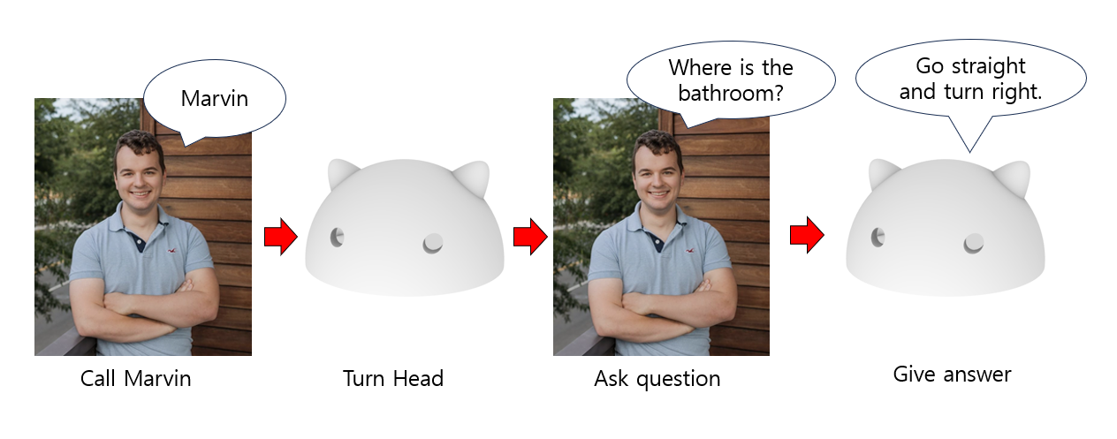
Introduction
Marvin, speech-based receptionist robot
Notes:
In the project, we built speech based receptionist robot Marvin that answers to people’s questions. For example, if a person calls “Marvin”, Marvin will turn the head to the person. And then when a person asks question something like “Where is the bathroom?”, Marvin will give answer like “Go straight and turn right”.

Slide 3
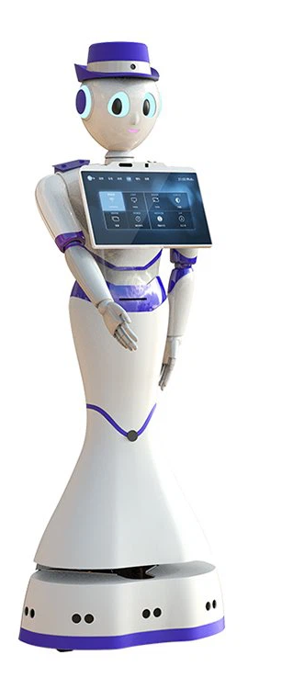
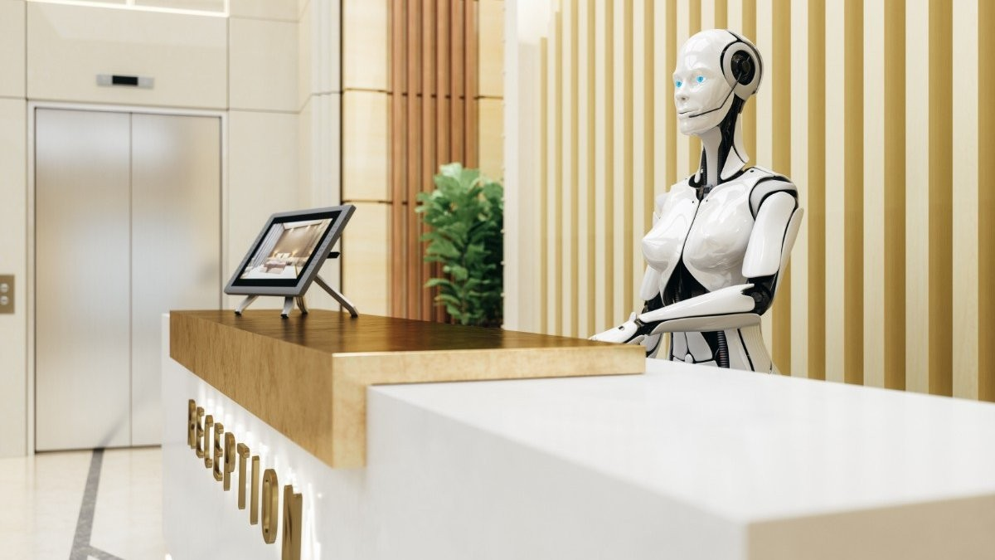
Introduction
Notes:
Marvin is receptionist robot, so it can be used in places like museum, hospital, exhibition and help people by giving responses to people’s questions. It can be in the information desk or roam around people, and provide information on things people are curious about, such as guiding the location of specific amenities.

Slide 4
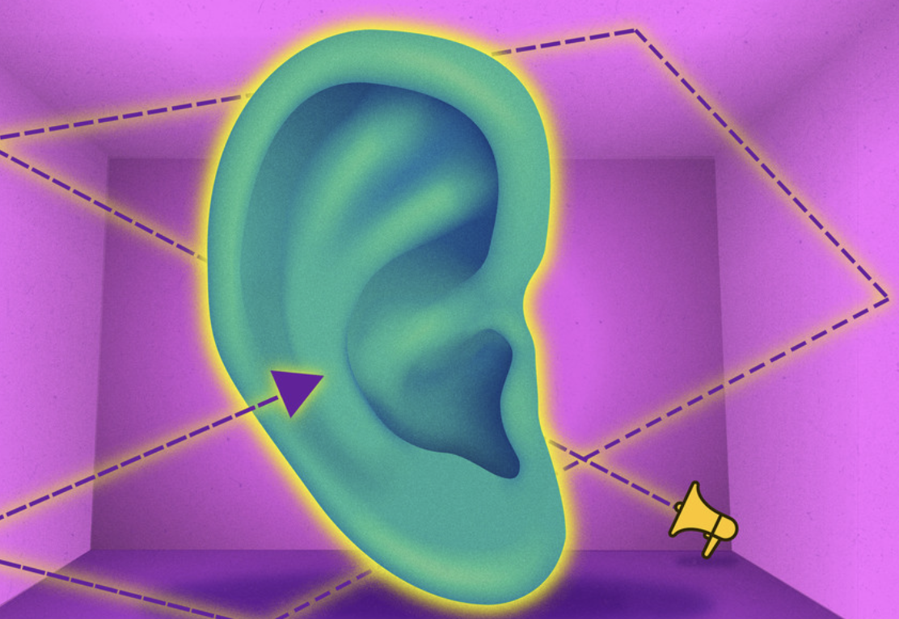
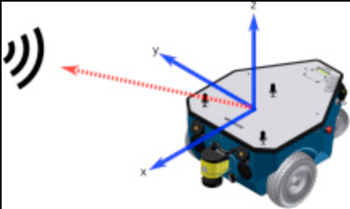

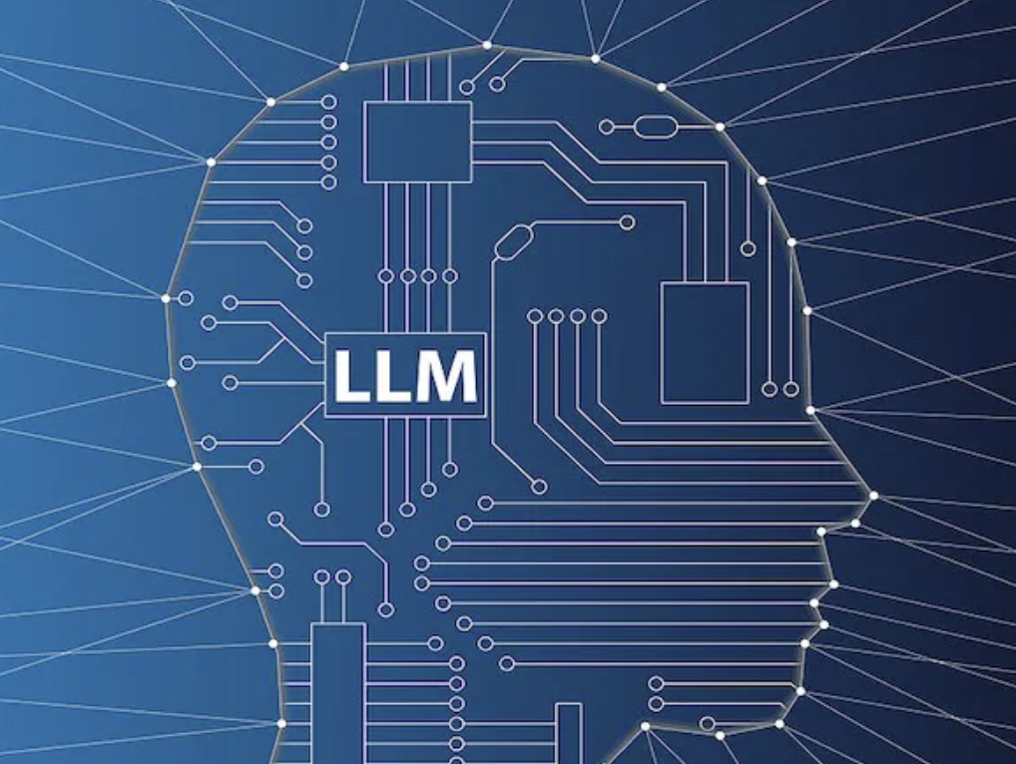
Motivation
MARVIN

Slide 5
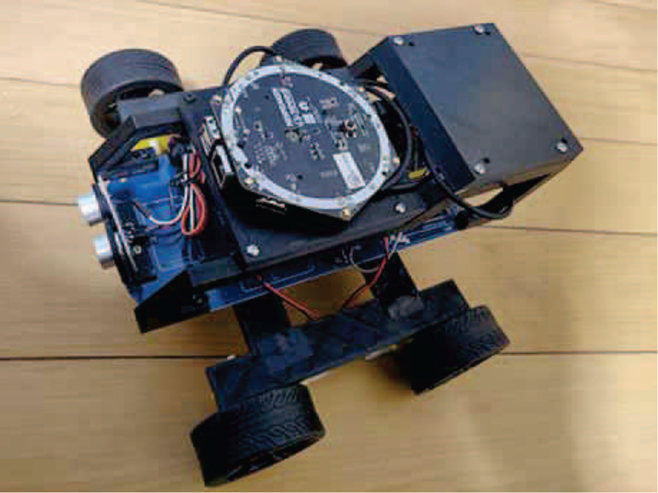
Existing Research - SSD, Keyword Spotting Robot
Functionality
Mobile Robot
Sound Source Detection
Keyword Spotting
Hardware
Arduino UNO
4WD Platform
ReSpeaker Core v2.0 Mic Array
[1] M. B. Andra and T. Usagawa, “Portable keyword spotting and sound source detection system design on mobile robot with Mini Microphone Array,” 2020 6th International Conference on Control, Automation and Robotics (ICCAR), 2020. doi:10.1109/iccar49639.2020.9108086

Slide 6
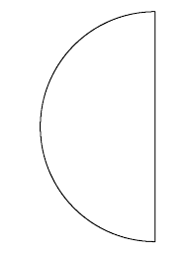
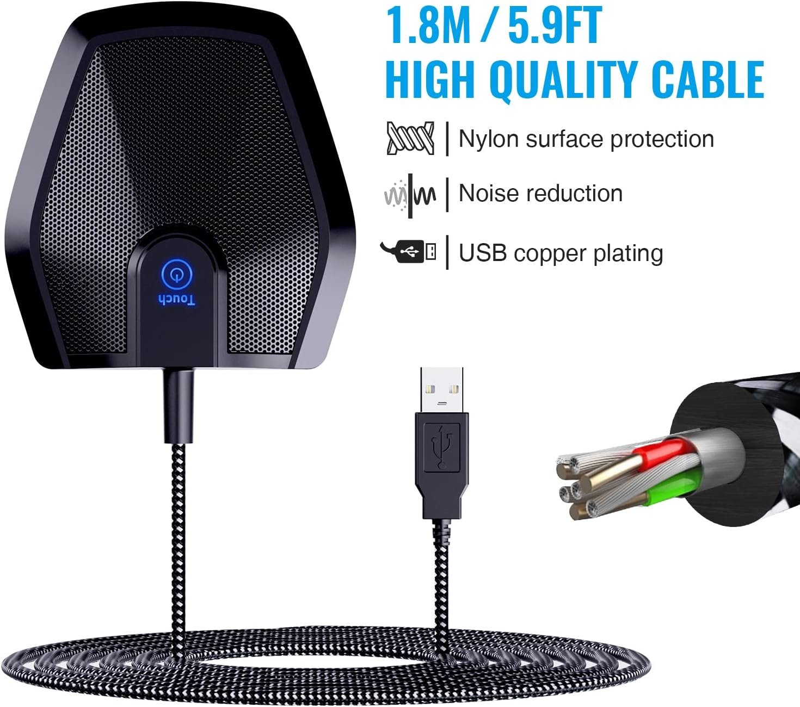
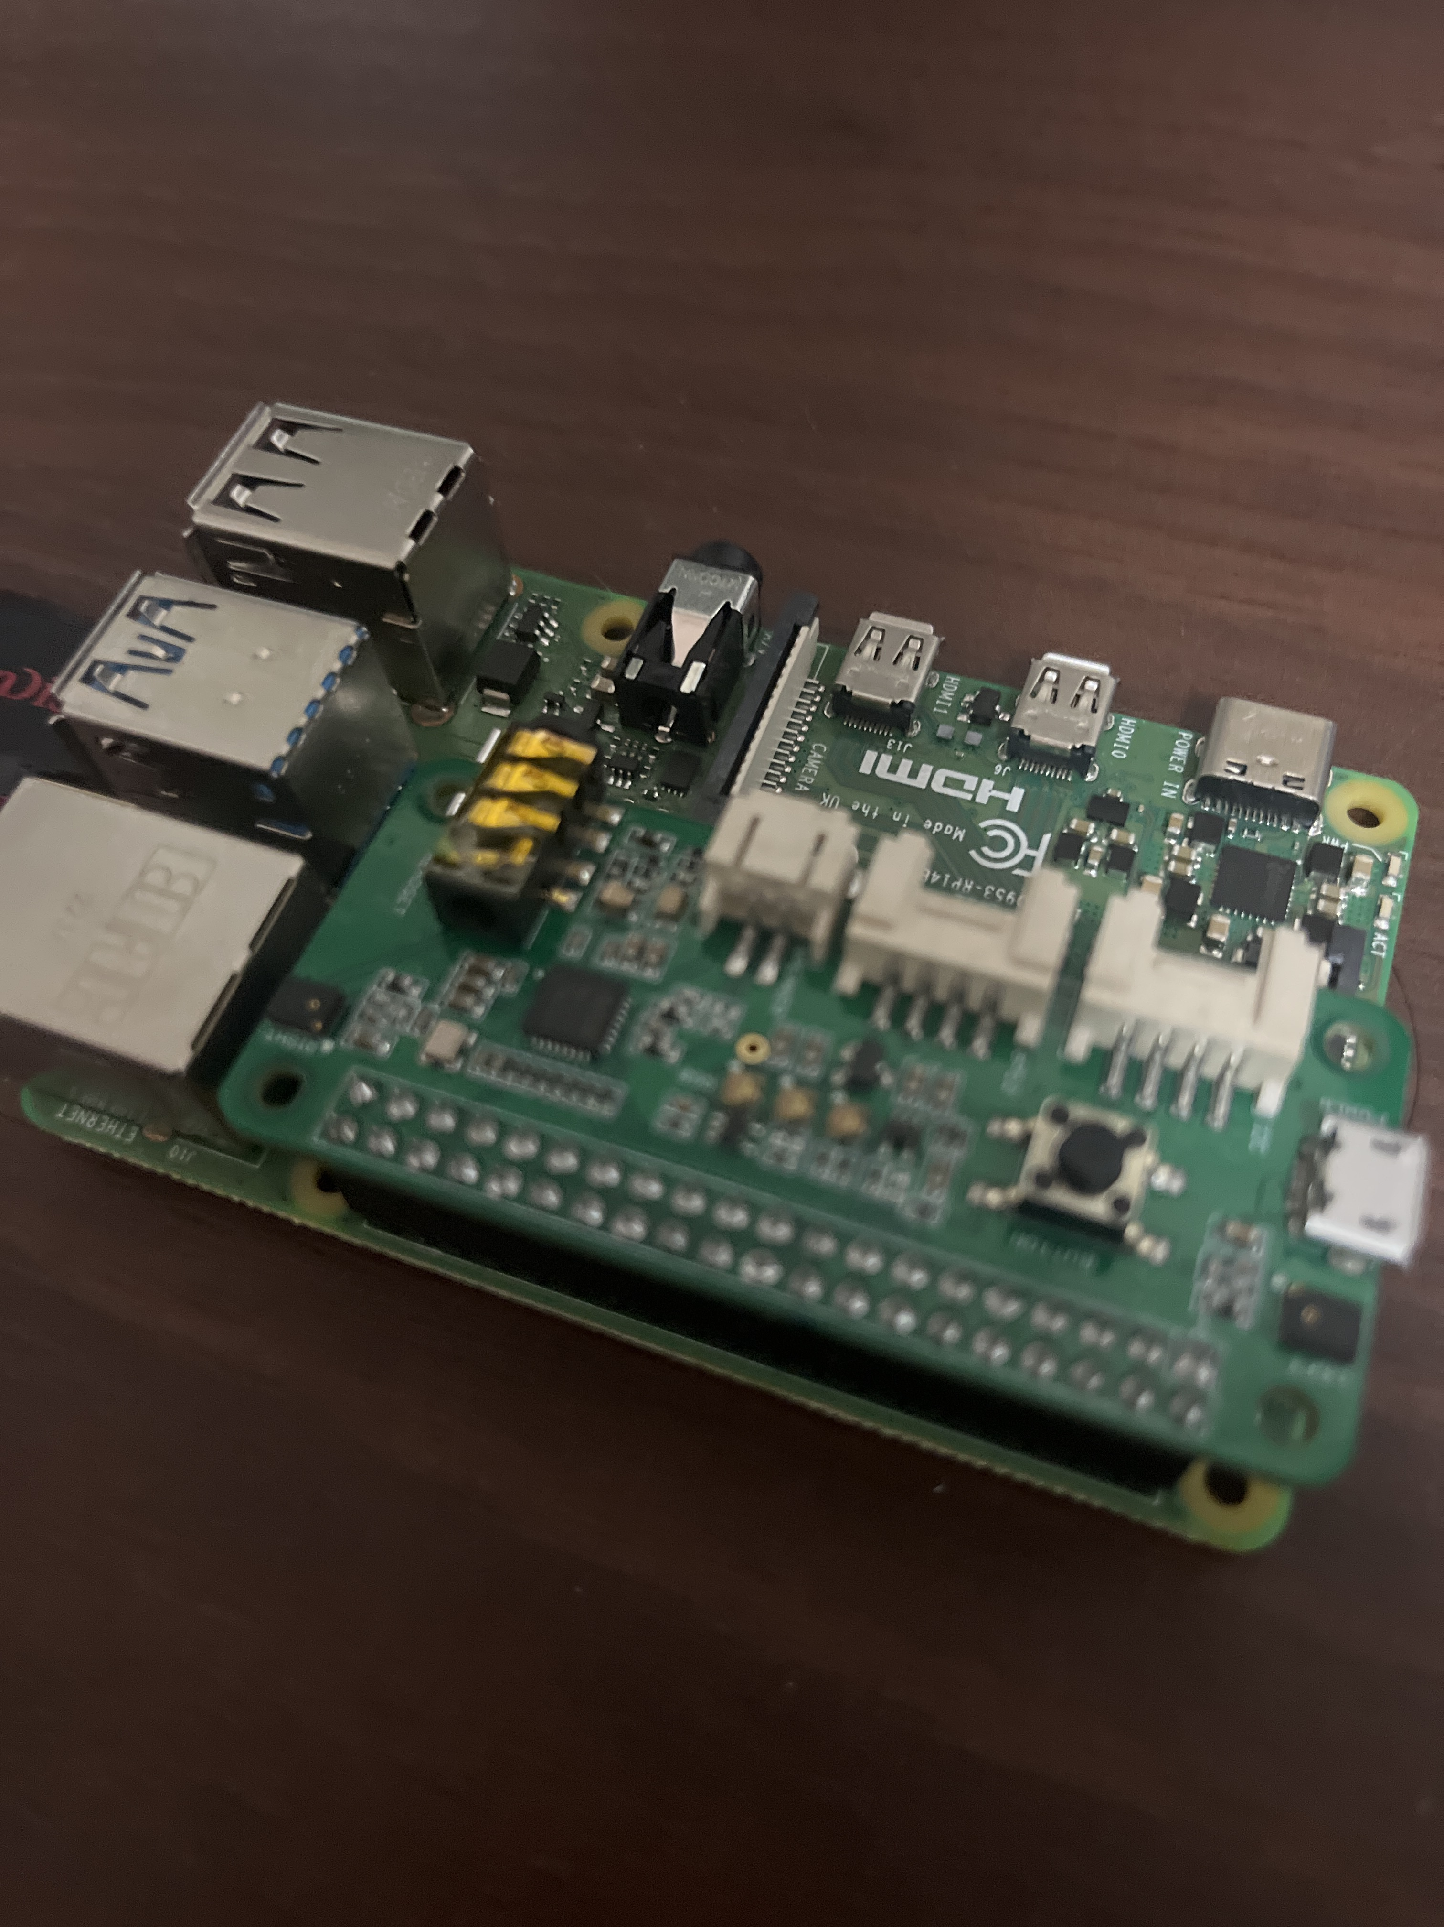
Plan A: Sound Source Detection
Conference Microphone
180° Acoustic FOV
60°
Raspberry Pi w/ SeeedStudio Microphone Array
R = 1m
Notes:
The original plan was to use a microphone array that attached to a Raspberry Pi we borrowed from the lab; however, though the product page advertised SSD for this product, the provided code only works for higher end microphones in the series.
We also planned on using this conference microphone to collect speech; however, shipping was delayed so much that it would not arrive in time, so we cancelled the order.

Slide 7

Plan B
60°
60°
Marvin!!
Where is the bathroom?
Marvin!!
Where is the professor?

Slide 8
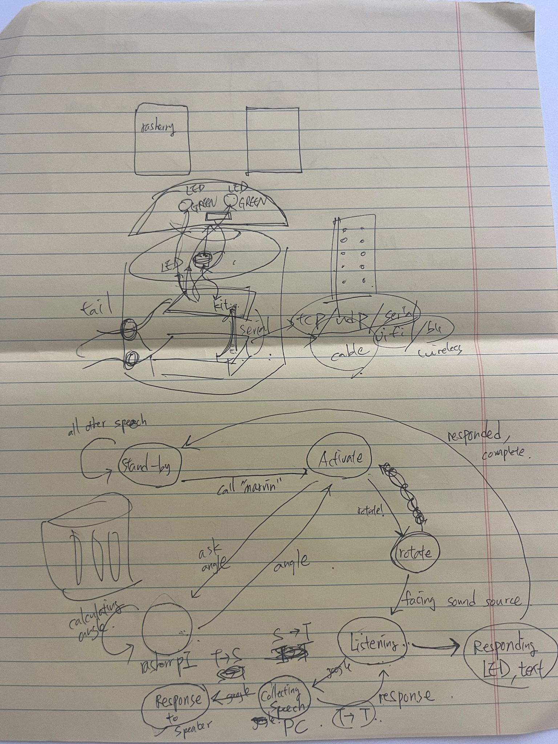
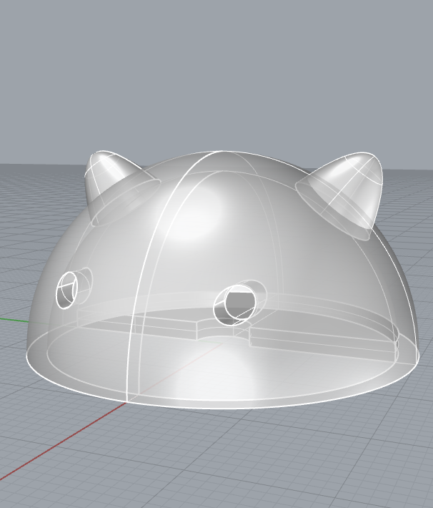
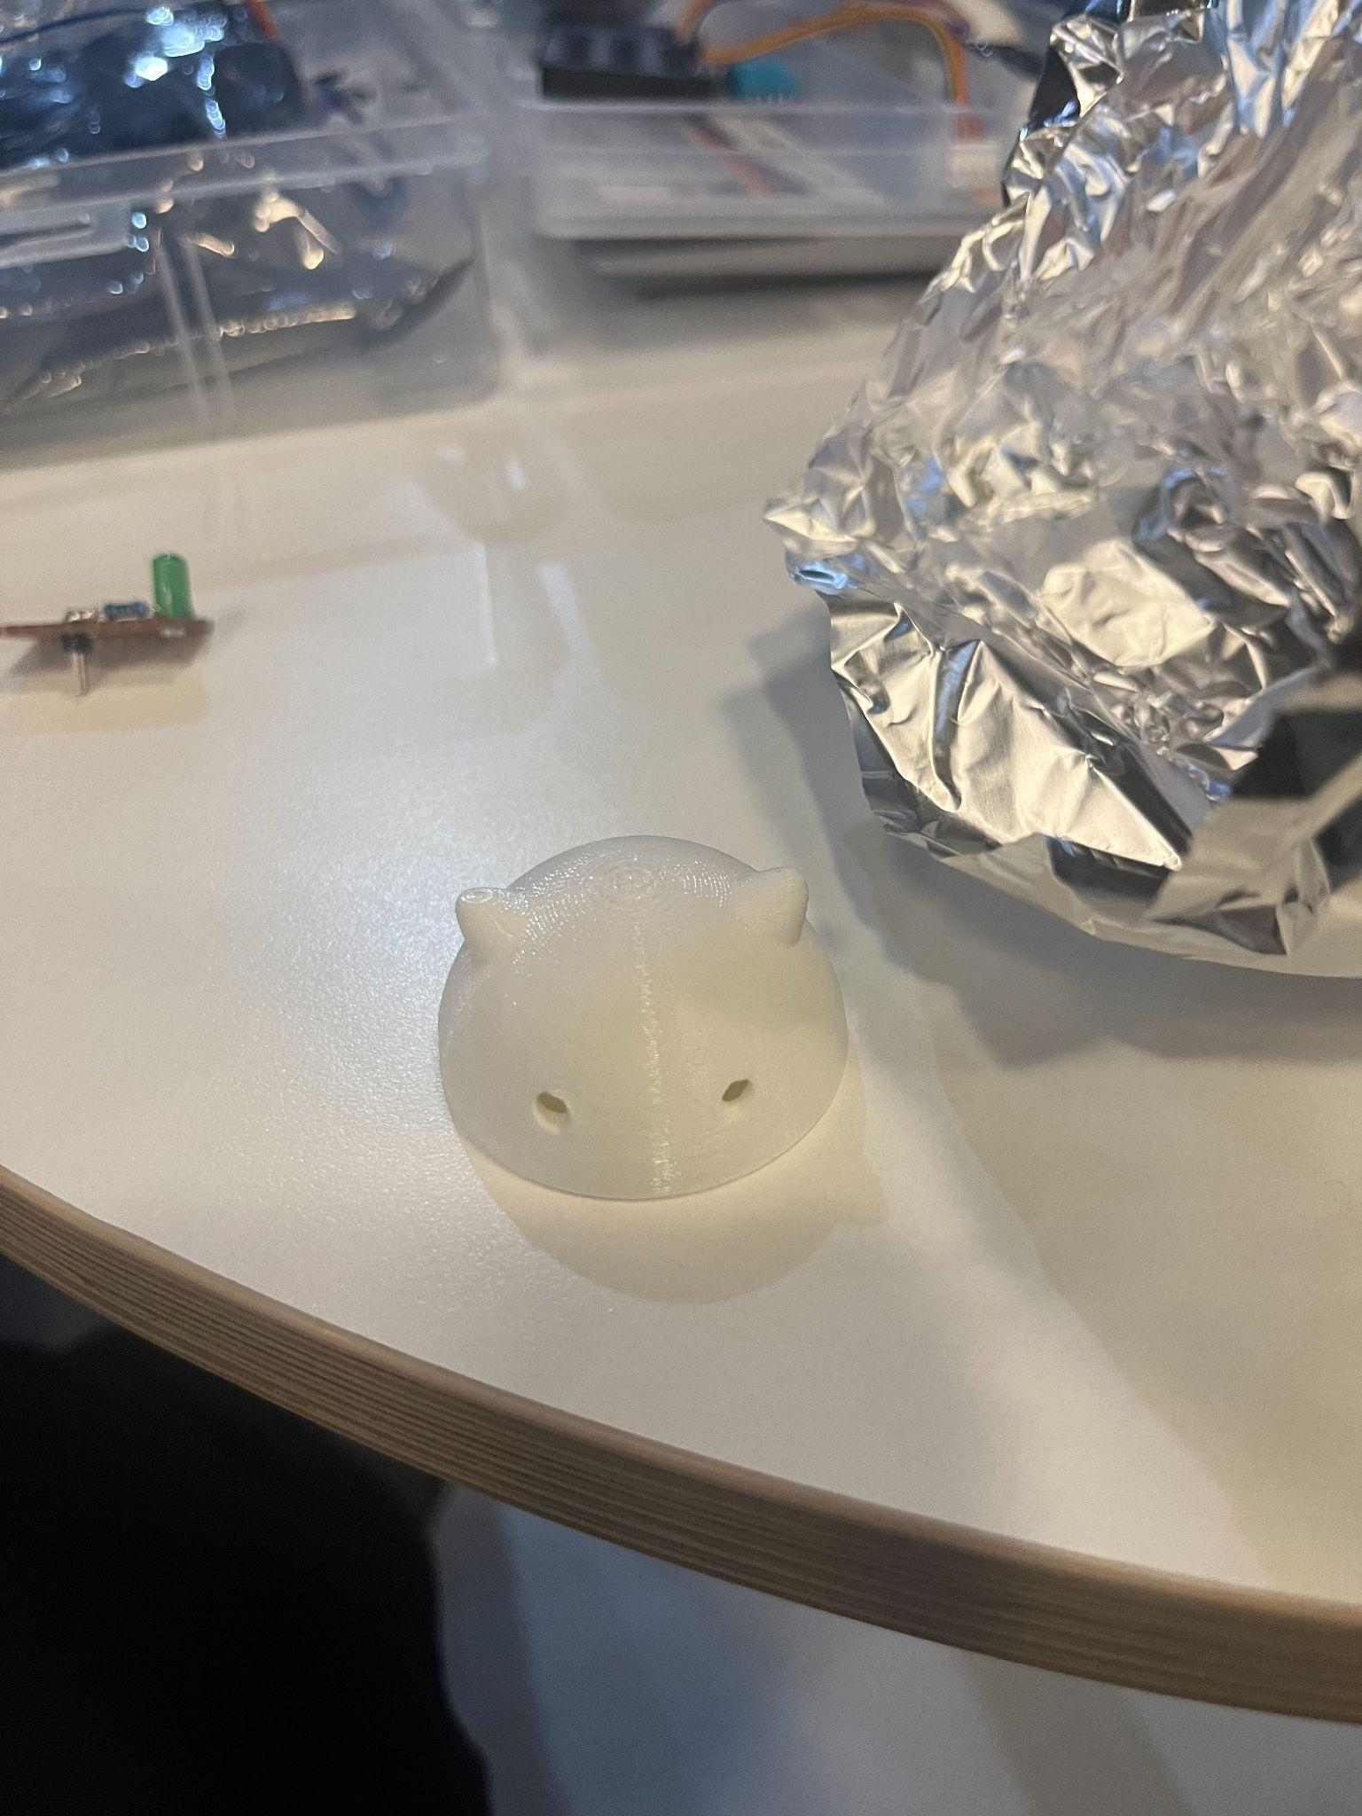
Design -Head
Sketch
3D Design
3D print
Notes:
For design of the robot, we first draw sketches on papers. Then, we designed it into 3D model by using software called Rhino. Then we printed it out with 3D printer. We inserted LEDs into the holes to make them appear like eyes, and we built ears to appear user-friendly.

Slide 9
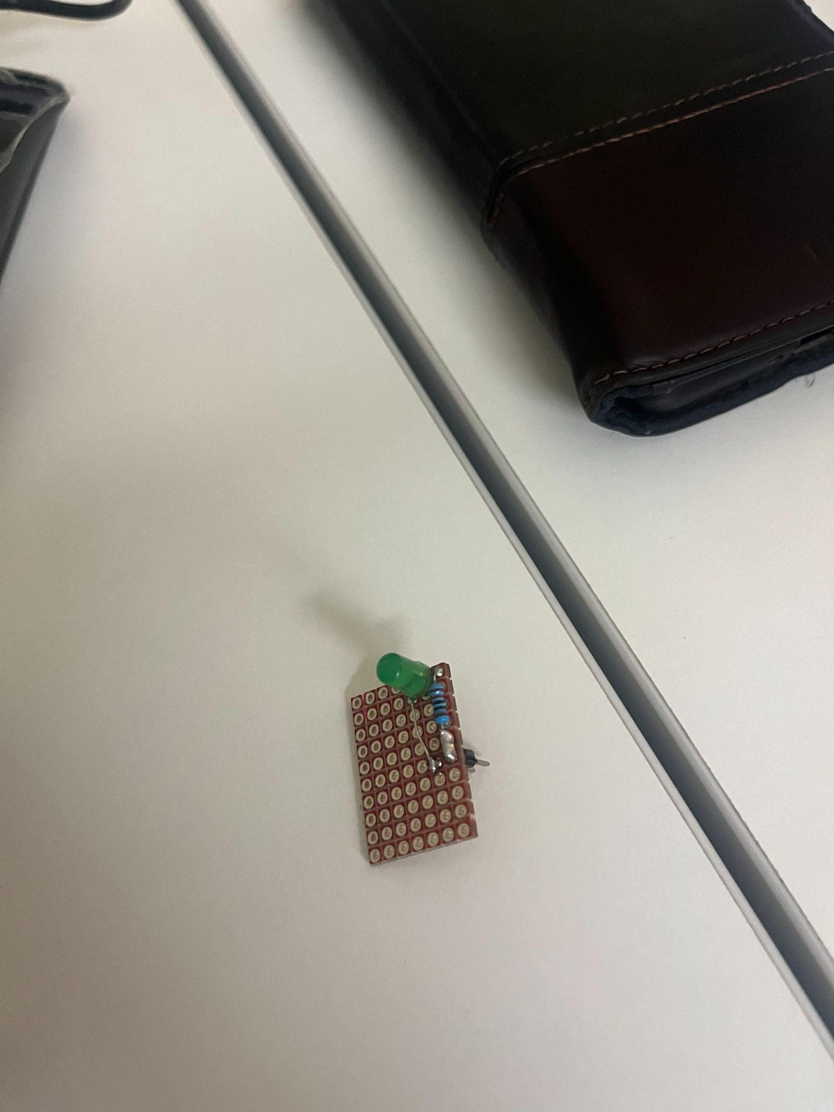
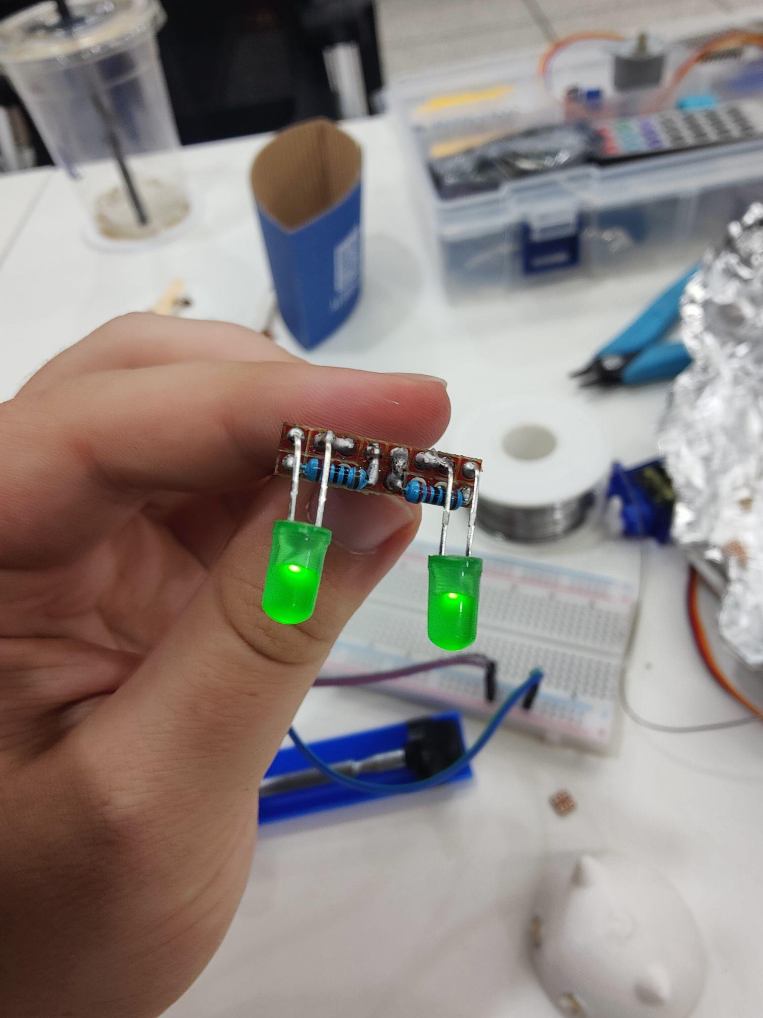
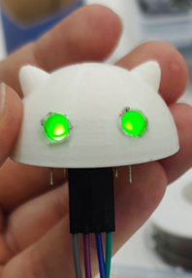
Design -Eyes
Original Board
Final Board
Complete Head
Notes:
Our original design had a single LED that would illuminate the inside of the head, so the eyes would only be holes; however, the LED was not bright enough to see the light, so we created a new board with a LED for each eye.
A soldering iron was used on the eye holes to allow the LEDs to fit perfectly in place.

Slide 10
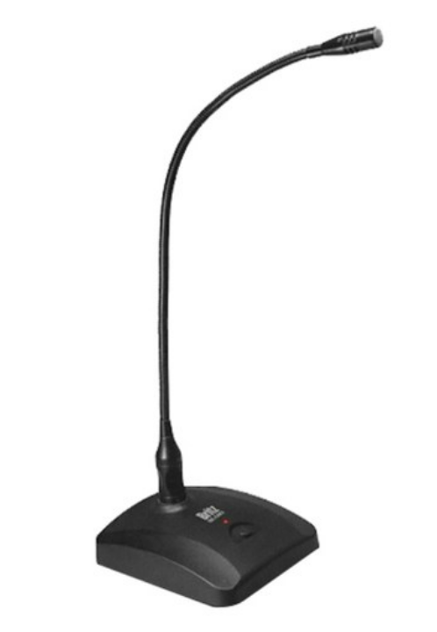
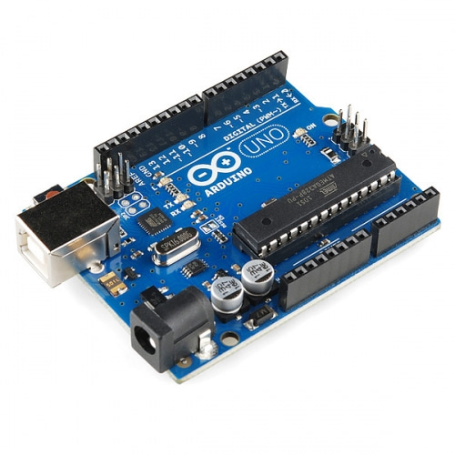
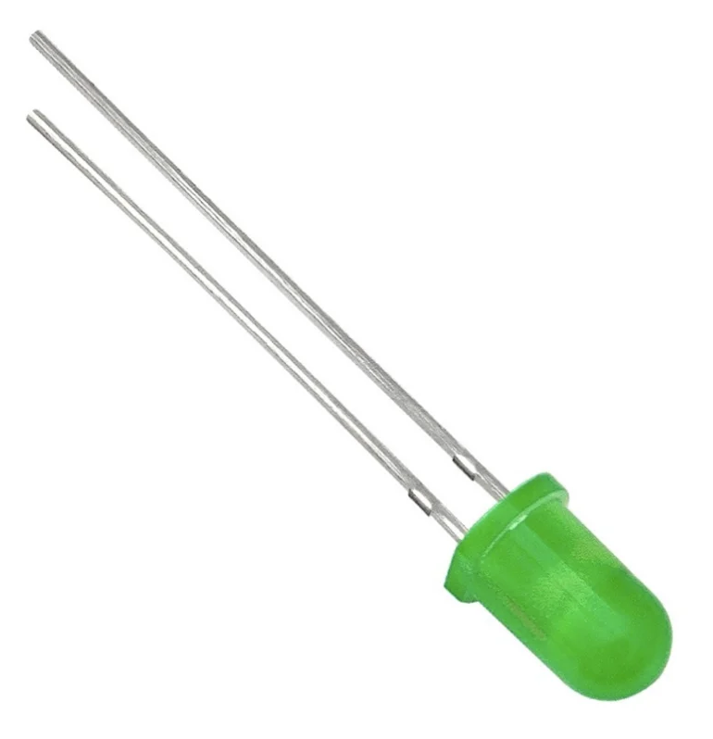
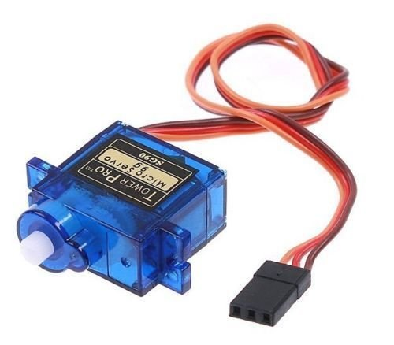
Hardware
Arduino UNO Board, 2 LEDs, Servo Motor, microphone
Notes:
For hardware of the robot, we used Arduino Uno board, 2 LEDs, Servo motor, and microphone. We used LEDs for turning lights on, and blinking when robot is in some particular state, and we used servo motor to turn the robot’s head towards the person asking question. And we used microphone for better speech recognition.

Slide 11
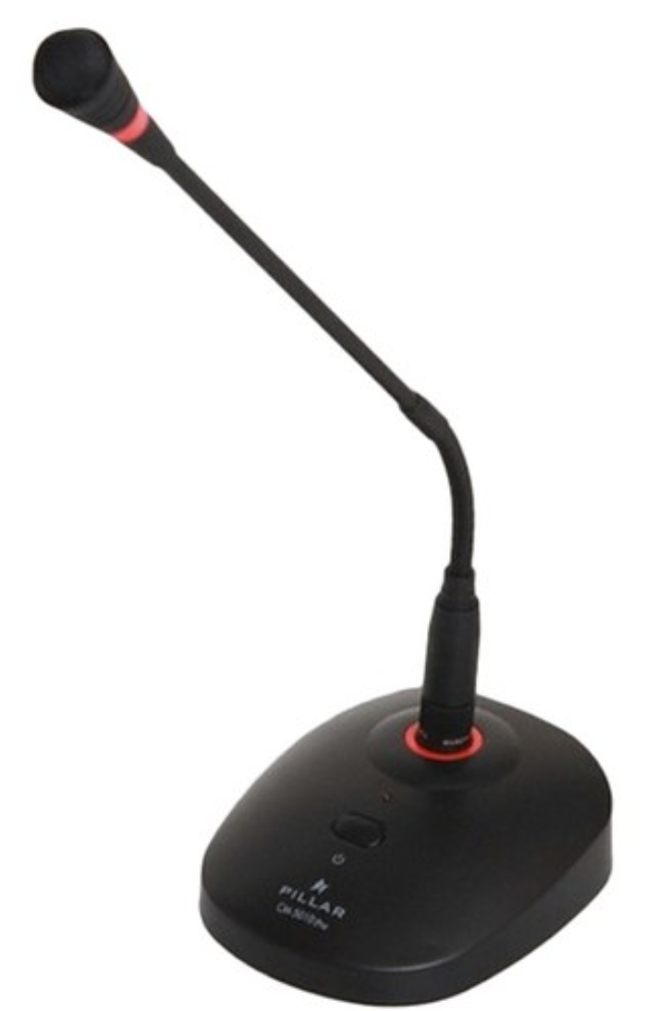

How Marvin Works -0
Complete
Answer
Serial Communication
Key word:
Marvin
Bathroom
Professor
Command to Marvin

Slide 12
How Marvin Works -1
Marvin!!
Hello, I am Marvin.
Do you need any help?
Where is the ‘bathroom’? /
Where is the ‘professor’?
Answer

Slide 13
How Marvin Works -2
Marvin!!
Hello, I am Marvin.
Do you need any help?
Where is the ‘elevator’?
Sorry,
I could not understand
what you are talking about.

Slide 14
How Marvin Works -3
Marvin!!
Hello, I am Marvin.
Do you need any help?
20 sec
….
Sorry, I cannot hear anything
20 sec
….
Sorry,
Try again

Slide 15
How Marvin Works -4
Kelvin!!
My name is Marvin.
If you have any questions,
call my name.
Marvin!!
Hello, I am Marvin.
Do you need any help?

Slide 16
Machine States
Finished Answer
IDLE
Keyword: “Marvin”
RESPONDING
ROTATING
Question Received
LISTENING
Facing Speaker

Slide 17
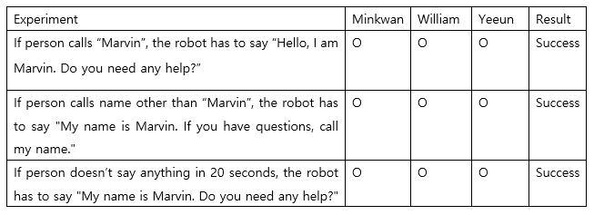
Experiment and Analysis
If ⅔ people succeed for each experiment, we assume it as “Success”
Recognizing “Marvin”
Notes:
We made some experiments to check if our robot worked well or not. We had 3 people in our team, so if 2 out of 3 people succeed for each experiment, we assumed it is ‘success’. First part of experiment was about whether the robot recognized Marvin correctly or not, and acting appropriately for each situation, and we could see that all the results were success.

Slide 18
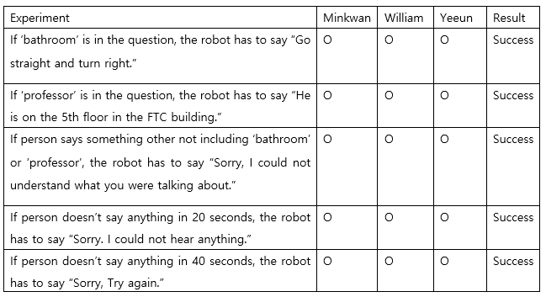
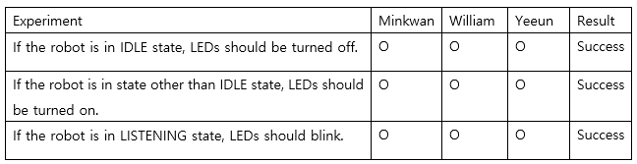
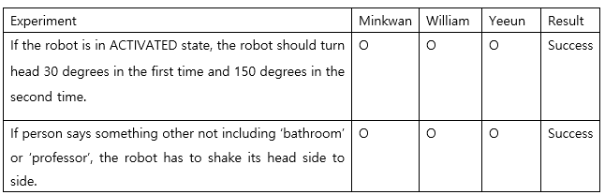
2. Recognizing questions and giving answers to the questions.
3. LED 4. Servo Motor
Notes:
The second part of experiment was to recognize people’s questions and giving correct answers for each situation. The third part of experiment was to see if LED works appropriately in each situation. The last part of experiment was to see if servo motor works appropriately in each situation. We could see that all results were success for experiments.

Slide 19
Lessons Learned
Consider Quality Instead of Only Technical Correctness When Testing
Do Not Implicitly Trust a Product Page
Test Each Component Before Soldering Even If They Are New

Slide 20
Future Research
Custom GPTs
OpenAI announced custom “GPT”
Create a GPT with building information
Locally run LLM
Enhanced security and privacy
Additional States to Allow Nuanced Dialogue
Design Physical Body
Mobile Robot to Guide Around the Building

Slide 21

Let’s try Marvin!!

